Slide 1
Tic-tac-toe WITH MINIMAX algorithm
FISAC Project for Artificial intelligence

Slide 2
introduction
To solve games using AI, we will introduce the concept of a game tree followed by a minimax algorithm. The different states of the game are represented by nodes in the game tree, very similar to the above planning problems. The idea is just slightly different. In the game tree, the nodes are arranged in levels that correspond to each player's turns in the game so that the “root” node of the tree (usually depicted at the top of the diagram) is the beginning position in the game. In tic-tac-toe, this would be the empty grid with no Xs or Os played yet. Under root, on the second level, there are the possible states that can result from the first player’s moves, be it X or O. We call these nodes the “children” of the root node.

Slide 3
introduction
Each node on the second level would further have as its children nodes the states that can be reached from it by the opposing player's moves. This is continued, level by level, until reaching states where the game is over. In tic-tac-toe, this means that either one of the players gets a line of three and wins, or the board is full and the game ends in a tie.

Slide 4
Problem statement
The goal is to design a computer opponent that plays Tic-Tac-Toe really well, this is enabled using AI concepts using Mini Max algorithm

Slide 5
MAIN OBJECTIVES
Perfect play : Create an AI agent that plays an Tic-Tac-Toe without any mistakes. It should either win or tie, depending upon the player’s moves.
Use Minimax : Apply the minimax method so the AI can pick the best moves by looking ahead at possible outcomes.
Simple interface : Design a clear and easy to use game interface board to play.
Quick response : The AI should think and make its moves quickly.

Slide 6
course outcome mapped
CO3- Analyze hypothetical game trees and knowledge representation.
A game tree is a graphical representation of a sequential game. It's a directed graph with nodes and edges.
In game theory, a game tree is a directed graph whose nodes are positions in a game and whose edges are moves.

Slide 7
Course concept : Minimax
Minimax is an artificial intelligence applied in two-player games, such as tic-tac-toe, checkers, chess, and go. These games are known as zero-sum games, because in a mathematical representation: one player wins (+1) and the other player loses (-1) or both of anyone not to win (0).

Slide 8
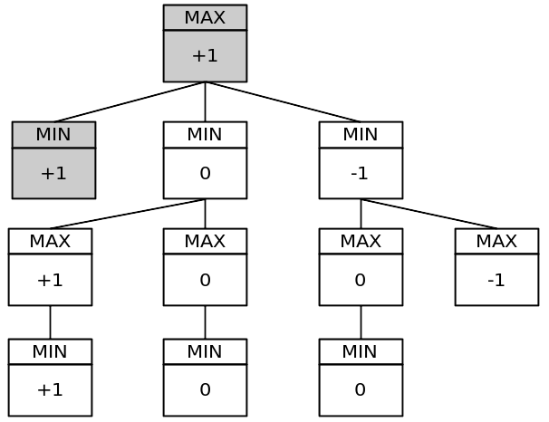
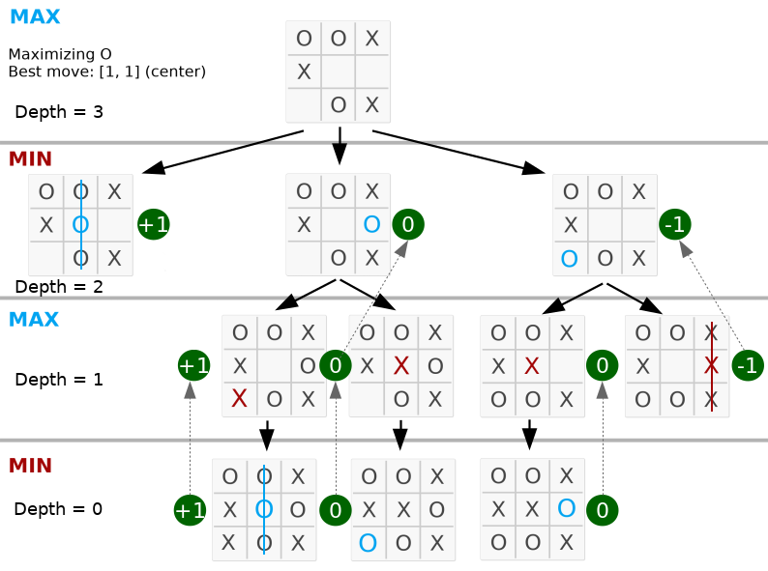

Slide 9
How it works
The algorithm searches, recursively, the best move that leads the AI player to win or not lose (draw). It considers the current state of the game and the available moves at that state, then for each valid move it plays (alternating *min* and *max*) until it finds a terminal state (win, draw or lose).

Slide 10
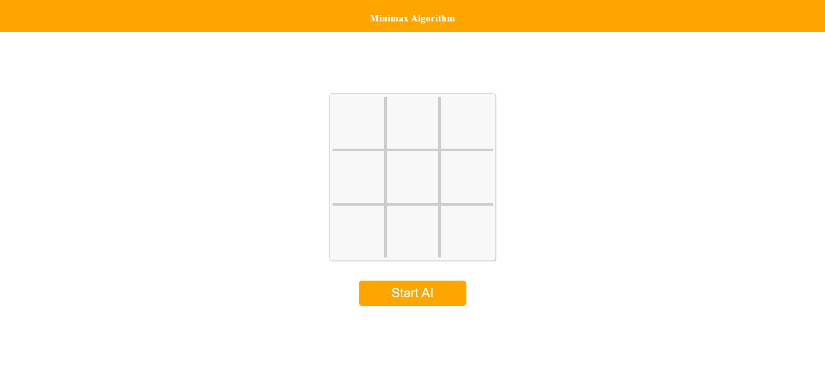

Slide 11
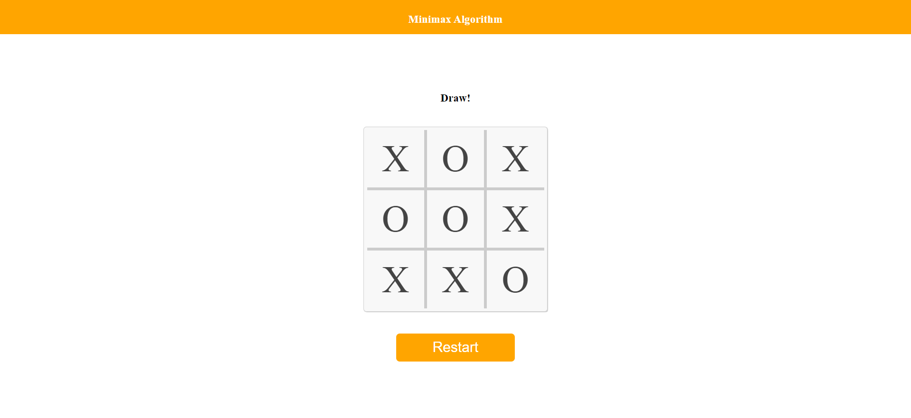

Slide 12
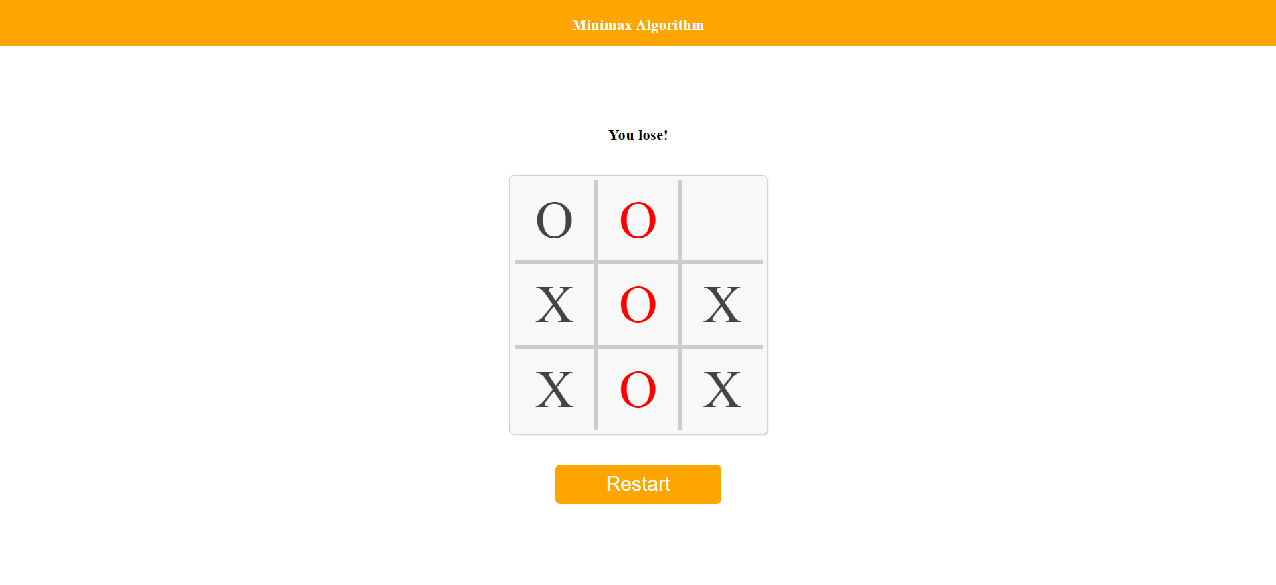

Slide 13
Members
Priyanshu Pranay, 200953170
Biprajit Deb, 200911245

